Slide 1
Chapter 8
Week 5
SNMP Management:
RMON

Slide 2
Objectives
Chapter 8 SNMP Management: RMON
Remote network monitoring, RMON
RMON1: Monitoring Ethernet LAN and token-ring LAN
RMON2: Monitoring upper protocol layers
Generates and sends statistics close to subnetworks to central NMS
RMON MIBs for RMON group objects
Chapter 8: Subramanian; Gonsalves & Rani (2010) - All sections

Slide 3
Interdiction
The success of SNMP management resulted in the prevalence of managed network components in the computer network. SNMPvl set the foundation for monitoring a network remotely from a centralized network operations center (NOC) and performing fault and configuration management. However, the extent to which network performance could be managed was limited. The characterization of the performance of a computer network is statistical in nature. This led to the logical step of measuring the statistics of important parameters in the network from the NOC and the development of remote monitoring (RMON) specifications.
8.1 WHAT IS REMOTE MONITORING?
We saw examples of SNMP messages going across the network between a manager and an agent in Section 5. 1 .4. We did this using a tool that "sniffs" every packet that is going across a local area network (LAN), opens it, and analyzes it. It is a passive operation and does nothing to the packets, which continue to proceed to their destinations. This is called monitoring or probing the network and the device that docs the function is called the network monitor or the probe.
Let us distinguish between the two components of a probe: (1) physical object that is connected to the transmission medium and (2) processor, which analyzes the data. If both are at the same place geographically, it is a local probe, which is how sniffers used to function. We will discuss this further in Chapter 9, when we consider management systems and tools.

Slide 4
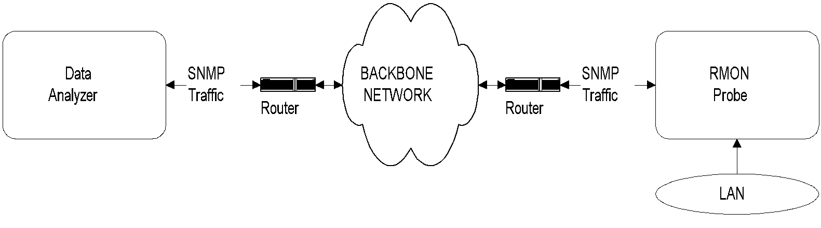
Chapter 8 SNMP Management: RMON
RMON Groups and Functions
RMON2
RMON1 specifically, performs numerous functions at the data link layer.
The data-gathering modules, which are LAN probes, gather data from the remotely monitored network comprising Ethernet and token-ring LANs. The data can serve as inputs to five sets of functions.
Applicable to Layers 3 and above
Functions similar to RMON1
Enhancement to RMON1
Defined conformance specifications and compliance
Functions
  Statistics on Ethernet, token ring, and hosts / conversations
  Filter group filters data prior to capture of data
  Generation of alarms and events
Ten groups divided into three categories
  Statistics groups (rmon 1, 2, 4, 5, 6, and 10)
  Event reporting groups (rmon 3 and 9)
  Filter and packet capture groups (rmon 7 and 8)
Groups with “2” in the name are enhancements with RMON2
RMON Components
RMON Probe
  Data gatherer - a physical device
Data analyzer
  Processor that analyzes data
Remote monitoring is monitoring the network using remotely positioned probes in various segments in the network.
RMON1 was initially defined for data link level parameters of Ethernet LAN. It was then extended to token-ring LAN.
RMON2 development followed to monitor and produce statistics for parameters associated with the upper layers, from the network to the application level.

Slide 5
Chapter 8 SNMP Management: RMON
RMON Components
RMON Probe
  Data gatherer - a physical device
Data analyzer
  Processor that analyzes data
  Notes
RMON Remote Network Monitoring

Slide 6
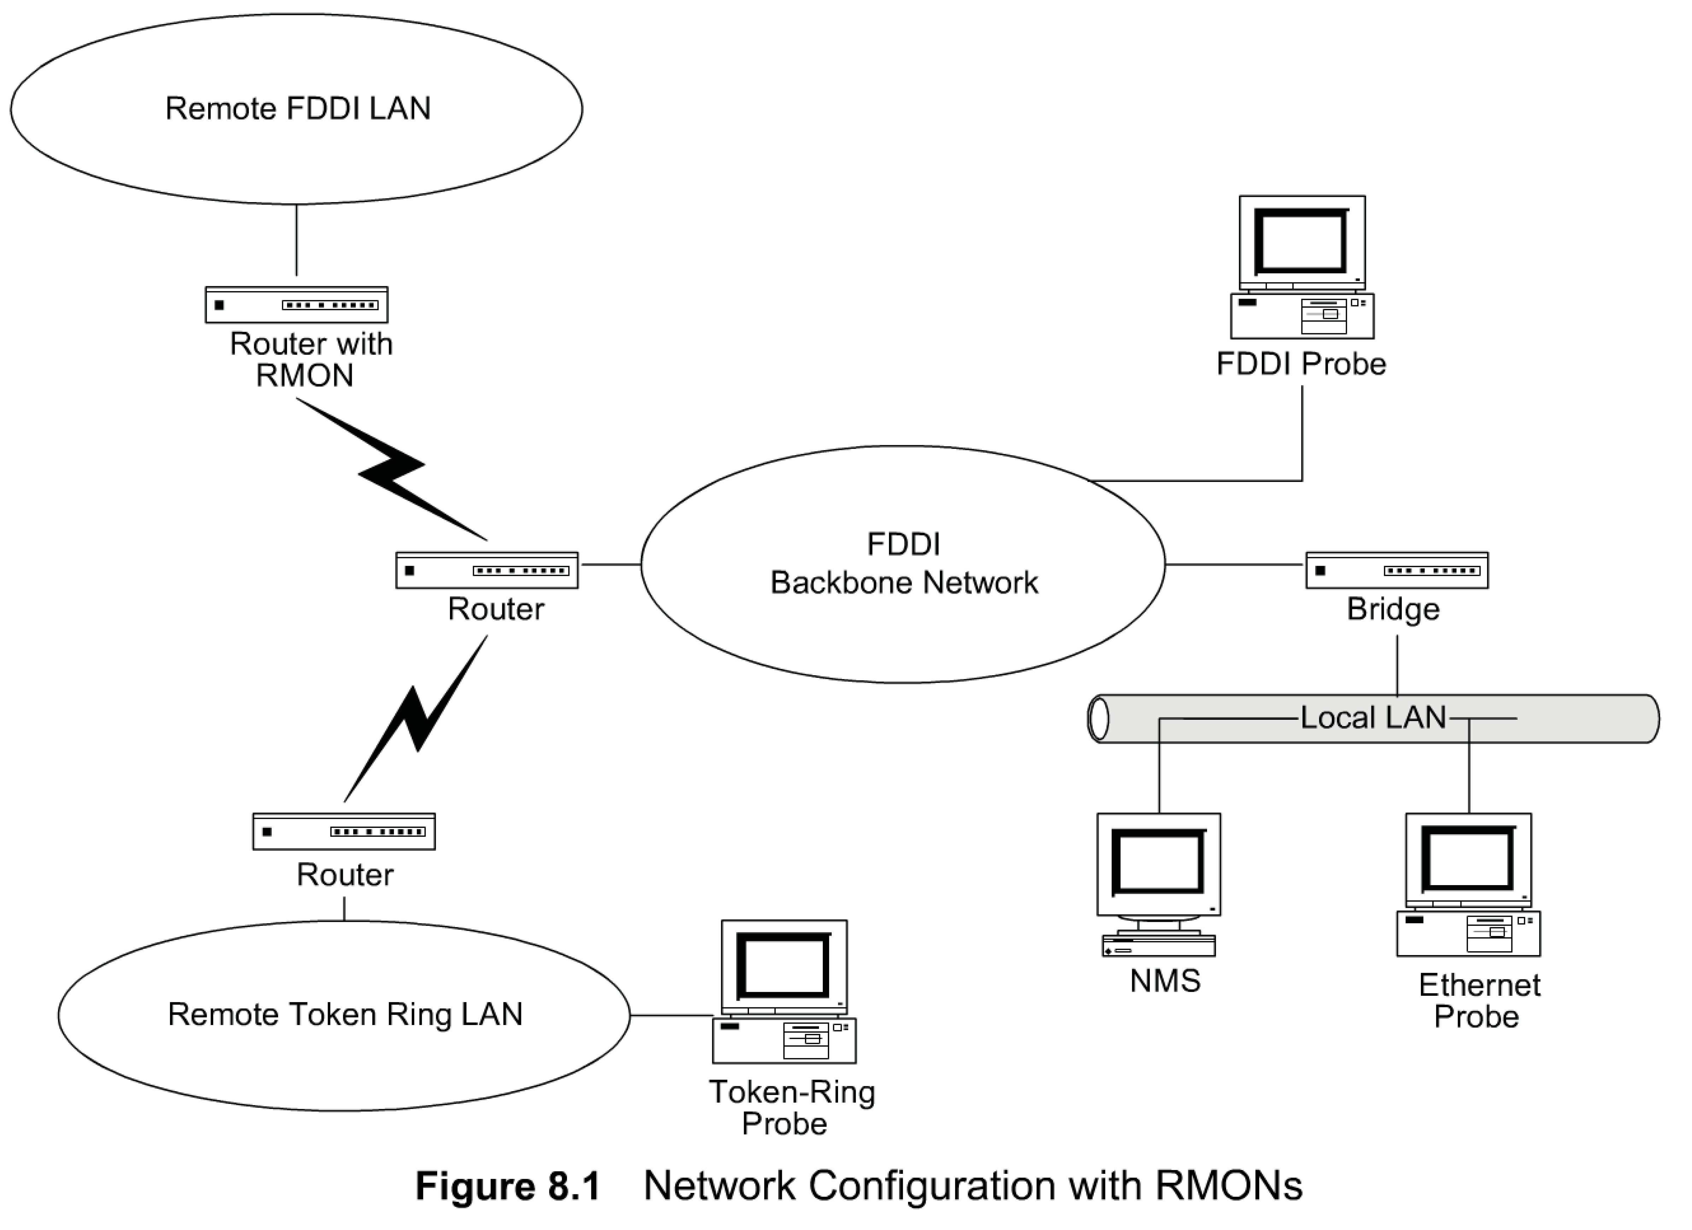
Chapter 8 SNMP Management: RMON
Network with RMONs
The monitored information gathered and analyzed locally can be transmitted to a remote network management station.
In such a case, remotely monitoring the network using a probe is referred to as remote network monitoring or RMON.
Figure 8. 1 shows a fiber-distributed data interface (FDDI) backbone network with a local Ethernet LAN. There are two remote LANs, one a token-ring LAN and another, an FDDI LAN, connected to the backbone network. The network management system (NMS) is on the local Ethernet LAN.
There is either an Ethernet probe or an RMON on the Ethernet LAN monitoring the local LAN.
The FDDI backbone is monitored by an FDDI probe via the bridge and Ethernet LAN.
A token-ring probe monitors the token-ring LAN. It communicates with the NMS via routers and the wide area network (WAN)
The remote FDDI is monitored by the built-in probe on the router.
The FDDI probe communicates with the NMS via the WAN. All four probes that monitor the four LANs and communicate with the NMS are RMON devices.
  Notes
Note that RMON is embedded monitoring remote
FDDI LAN
Analysis done in NMS

Slide 7
Chapter 8 SNMP Management: RMON
RMON Benefits
Monitors and analyzes locally and relays data; Less load on the network
Needs no direct visibility by NMS; More reliable information
Permits monitoring on a more frequent basis and hence faster fault diagnosis
Increases productivity for administrators
  Notes

Slide 8
Chapter 8 SNMP Management: RMON
RMON Benefits
The use of RMON devices has several advantages. First, each RMON device monitors the local network segment and does the necessary analyses. It relays the necessary information in both solicited and unsolicited fashion to the NMS. For example, RMON could be locally polling network elements in a segment. If it detects an abnormal condition, such as heavy packet loss or excessive collisions, it would send an alarm. Because the polling is local, the information is more reliable. This example of local monitoring and reporting to a remote NMS significantly reduces SNMP traffic in the network. This is especially true for the segment in which the NMS resides, as all the monitoring traffic would otherwise converge there.
another advantage. RMON reduces the necessity of agents in the network to be visible at all times to the NMS.
he NMS was set to indicate a node failure if three successive ICMP packets did not receive responses. Increasing the number of packets needed to indicate a failure stopped the failure indication. This demonstrates the third advantage.
There are more chances that the monitoring packets, such as ICMP pings, may get lost in long-distance communication, especially under heavy traffic conditions. This may wrongly be interpreted by the NMS as the managed object being down. RMON pings locally and hence has less chance of losing packets, thus increasing the reliability of monitoring.
Another advantage of local monitoring using RMON is that individual segments can be monitored on a more continuous basis. This provides better statistics and greater ability for control. Thus, a fault could be diagnosed quicker by the RMON and reported to the NMS. In some situations, a failure could even be prevented by proactive management.
The overall benefits of implementing RMON technology in a network are higher network availability for users and greater productivity for administrators. A study report [CISCO/RMON] indicates increased productivity of several times for network administrators using RMON in their network.

Slide 9
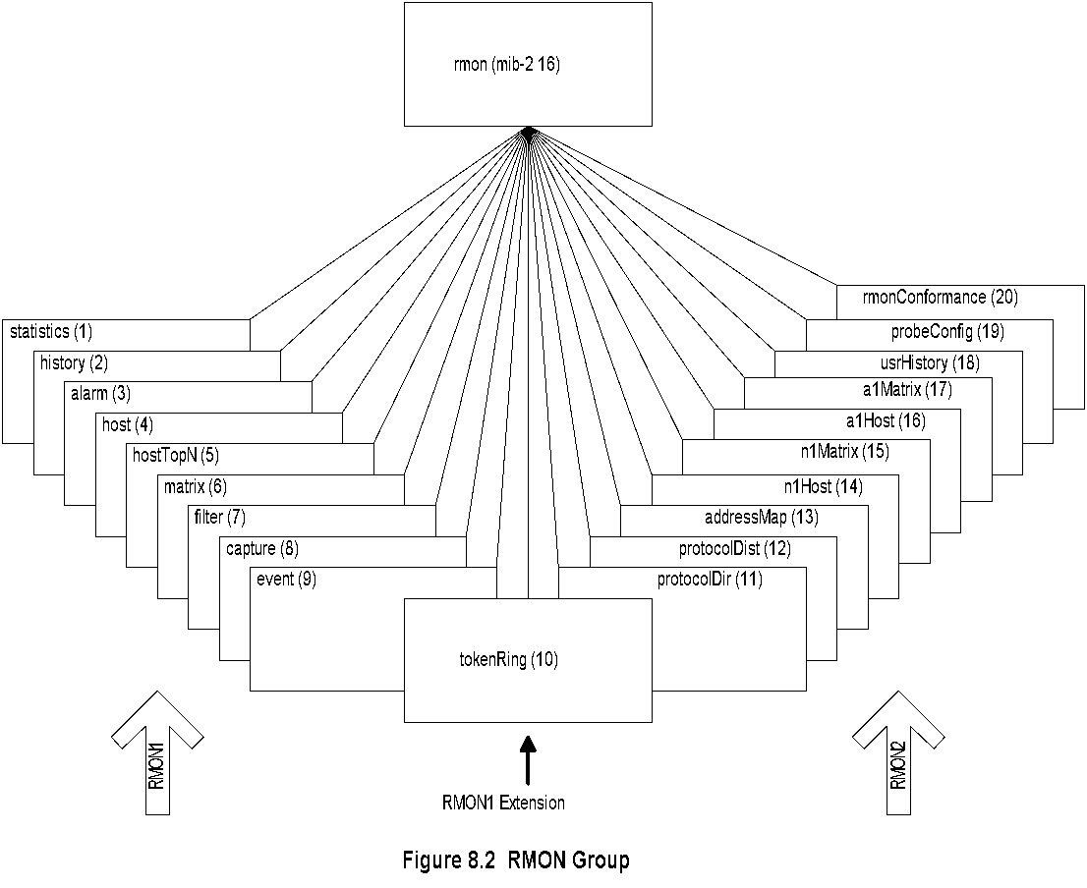
Chapter 8 SNMP Management: RMON
RMON MIB
The RMON structure of management information is similar to SMIv2 in defining object types. The Remote Network Monitoring Management Information Base (RMON MIB) defining RMON groups has been developed and defined in three stages.
The original RMON MIB, now referred to as RMON1 was developed for Ethernet LAN (obsolete).
There are two data types introduced
as textual conventions, and ten MIB groups (rmon 1 to rmon 10), as shown in Figure 8.2.
Token-ring extensions to RMON1 use for remote monitoring, it addressed parameters at the OSI layer 2 level only.
RMON2 groups (rmon 11-20) for the higher layers.
  Notes
RMON1: Ethernet RMON groups (rmon 1 - rmon 9)
RMON1: Extension: Token ring extension (rmon 10)
RMON2: Higher layers (3-7) groups (rmon 11 - rmon 20)

Slide 10
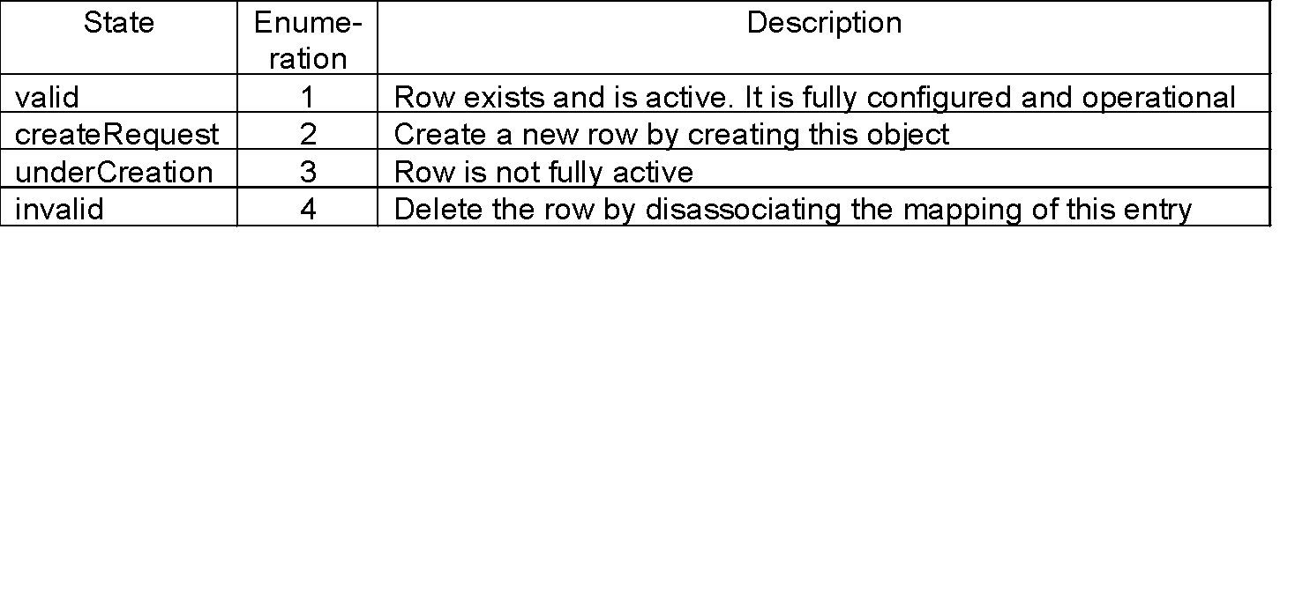
Chapter 8 SNMP Management: RMON
Row Creation & Deletion
Table 8.1 EntryStatus Textual Convention
EntryStatus data type introduced in RMON
EntryStatus (similar to RowStatus in SNMPv2)
used to create and delete conceptual row
Only 4 states in RMON compared to 6 in SNMPv2
  Notes
RMON1 Textual Conventions
Two new data types that are defined in RMON1 textual conventions are OwnerString and EntryStatus. Both these data types are extremely useful in the operation of RMON devices.
RMON devices are used by management systems to measure and produce statistics on network elements.

Slide 11
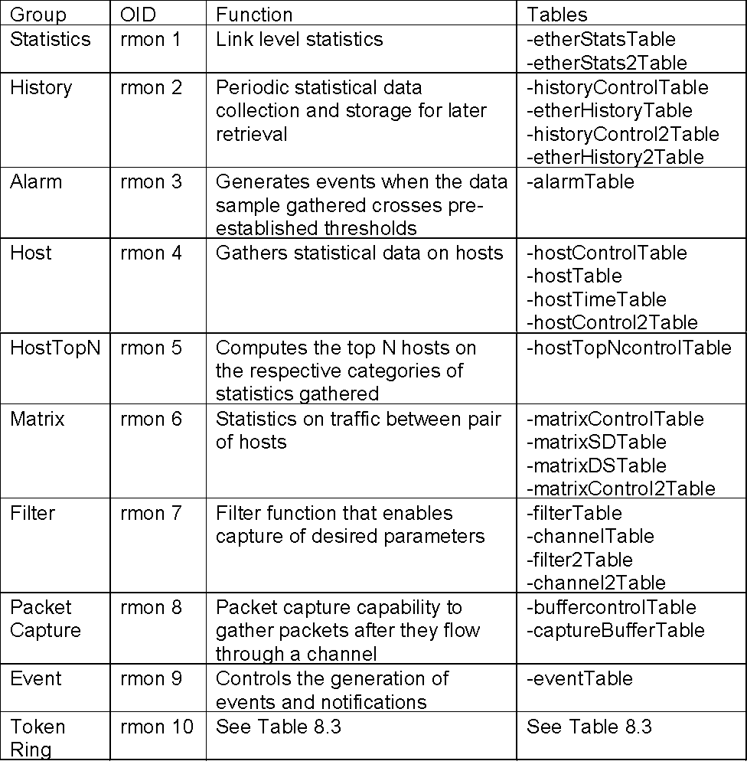
Chapter 8 SNMP Management: RMON
RMON1 MIB Groups & Tables
  Notes
Ten groups divided into three categories
  Statistics groups (rmon 1, 2, 4, 5, 6, and 10)
  Event reporting groups (rmon 3 and 9)
  Filter and packet capture groups (rmon 7 and 8)
Groups with “2” in the name are enhancements with RMON2

Slide 12
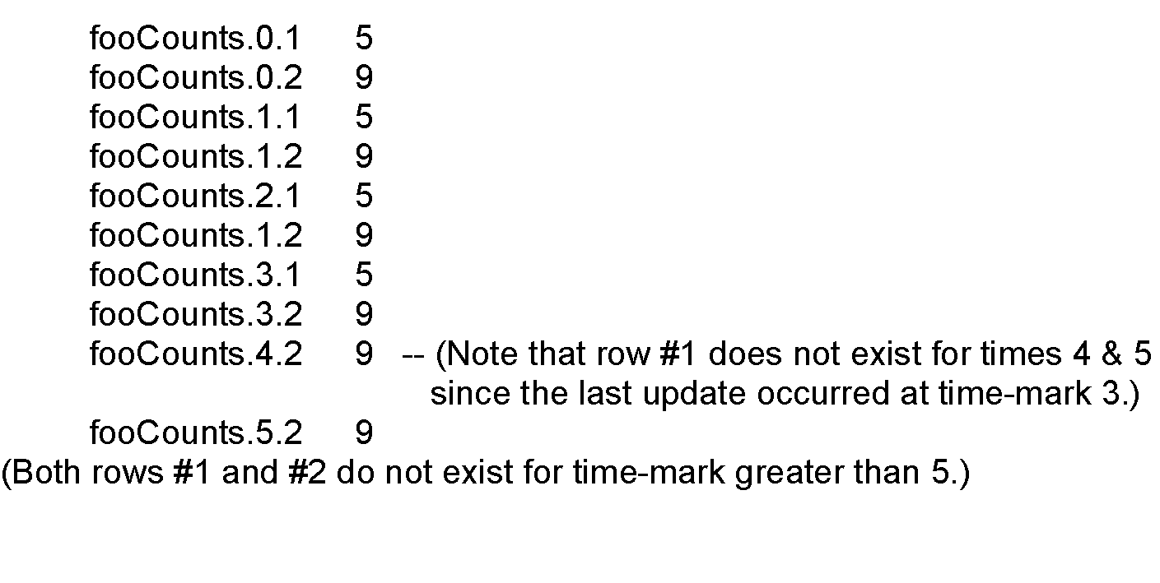
Chapter 8 SNMP Management: RMON
Textual Convention:
LastCreateTime and TimeFilter
LastCreateTime tracks change of data with the
changes in control in the control tables
Timefilter used to download only those rows that
changed after a particular time
FooTable (bold indicating the indices):
fooTimeMark fooIndex fooCounts
  Notes
Bold objects (fooTimeMark and fooIndex) are
indices
Network Management: Principles and Practice
© Mani Subramanian 2010
*

Slide 13
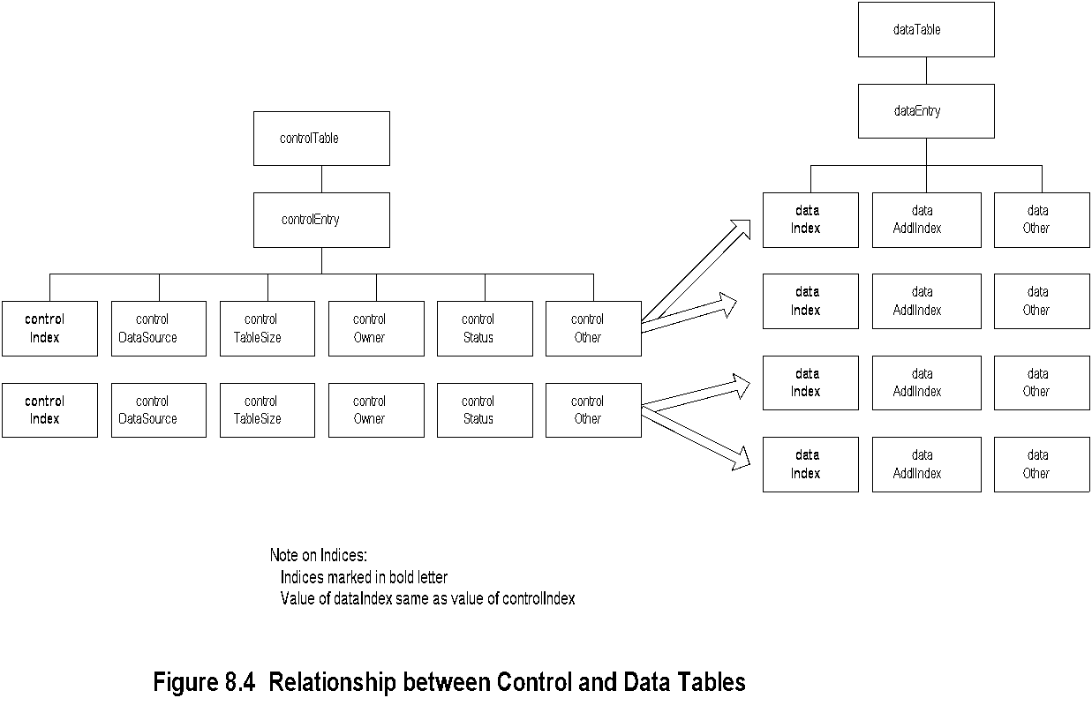
Chapter 8 SNMP Management: RMON
Control and Data Tables
The data table contains rows (instances) of data. The control table defines the instances of the data rows in the data table and is settable to gather and store different instances of data.
The relationship between the control table and the data table is illustrated in a generic manner in Figure 8.4. The value of the data index in the data table is the same as the value of control index in the control table.
  Notes
Control table used to set the instances of data
rows in the data table
Values of data index and control index are the same

Slide 14
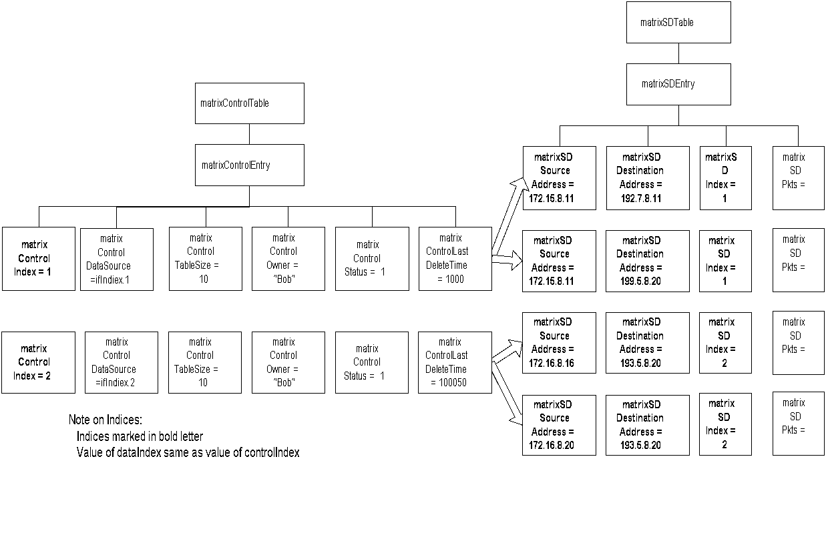
Chapter 8 SNMP Management: RMON
Matrix Control and SD Tables
  Notes
matrixSDTable is the source-destination table
controlDataSource identifies the source of the data
controlTableSize identifies entries associated with the data source
controlOwner is creator of the entry

Slide 15
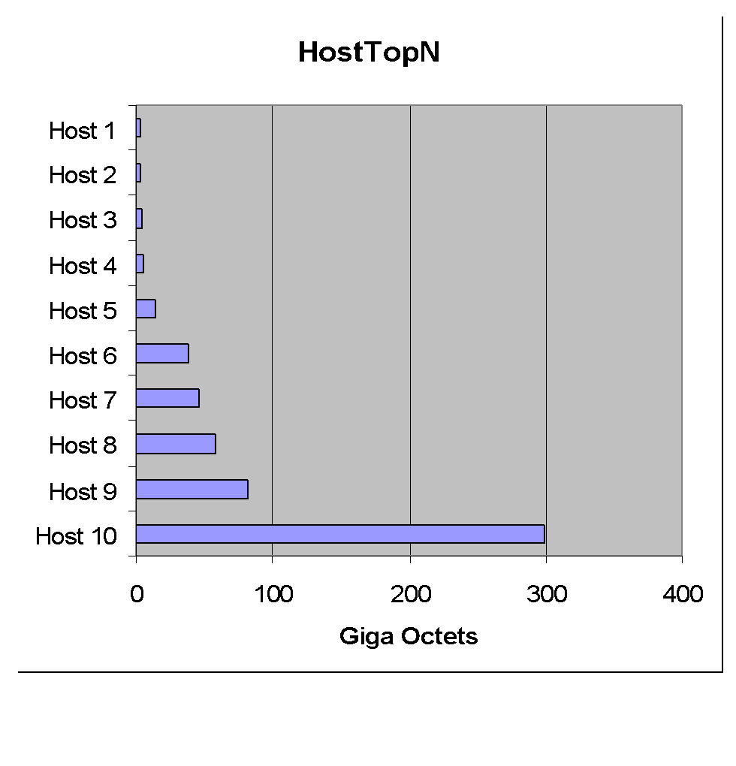
Chapter 8 SNMP Management: RMON
Host Top N Group Example
  Notes
Network Management: Principles and Practice
© Mani Subramanian 2010
*

Slide 16
RMON1 Common and Ethernet Groups
We have so far covered the global picture of RMON1 Ethernet MIB and how data and control tables are related to each other. Let us now address the nine RMON1 common and Ethernet groups.
Statistics Group. The statistics group contains statistics measured by the probe for each monitored Ethernet interface on a device.
History Group. The history group consists of two subgroups: the history control group and the history (data) group. The history control group controls the periodic statistical sampling of data from various types of networks. The control table stores configuration entries comprising interface, polling period, and other parameters.
Alarm Group. The alarm group periodically takes statistical samples on specified variables in the probe and compares them with the pre-configured threshold stored in the probe.
Host Group. The host group contains information about the hosts on the network. It compiles the list of hosts by looking at the good packets traversing the network and extracting the source and destination MAC addresses.
Host Top N Group. The host top N group performs a report-generation function for ranking the top N hosts in the category of the selected statistics.
Matrix Group. The matrix group stores statistics on the conversation between pairs of hosts. An entry is created for each conversation that the probe detects. There are three tables in the group. The matrixControlTable controls the information to be gathered. The matrixSDTable keeps track of the source to destination conversations; and the matrixDSTable keeps data based on destination to source traffic.
Filter Group. The filter group is used to filter packets to be captured based on logical expressions. The stream of data based on a logical expression is called a "channel." The group contains a filter table and a channel table. The filter table allows packets to be filtered with an arbitrary filter expression, a set of filters associated with each channel.
Packet Capture Group. The packet capture group is a post-filter group. It captures packets from each channel based on the filter criteria of packet and channel filters in the filter group.
Event Group. The event group controls the generation and notification of events. Both the rising alarm and the falling alarm can be specified in the eventTable associated with the group. Besides the transmittal of events, a log is maintained in the system.

Slide 17
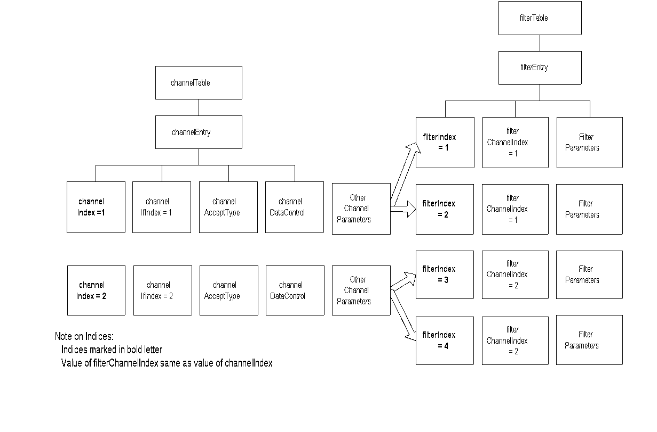
Chapter 8 SNMP Management: RMON
Filter Group
  Notes
Filter group used to capture packets defined by
logical expressions
Channel is a stream of data captured based on a
logical expression
Filter table allows packets to be filtered with an
arbitrary filter expression
A row in the channel table associated with multiple
rows in the filter table
Capture table accepts data if test of any row
in the filter table passes the test
Network Management: Principles and Practice
© Mani Subramanian 2010
*

Slide 18
Chapter 8 SNMP Management: RMON
Packet Capture Group
Channel
Table
Filter
Table
(many
for
each
channel)
Capture
Buffer
Table
(One
entry
per
channel)
  Notes
Packet capture group is a post-filter group
Buffer control table used to select channels
Captured data stored in the capture buffer table
Network Management: Principles and Practice
© Mani Subramanian 2010
*

Slide 19
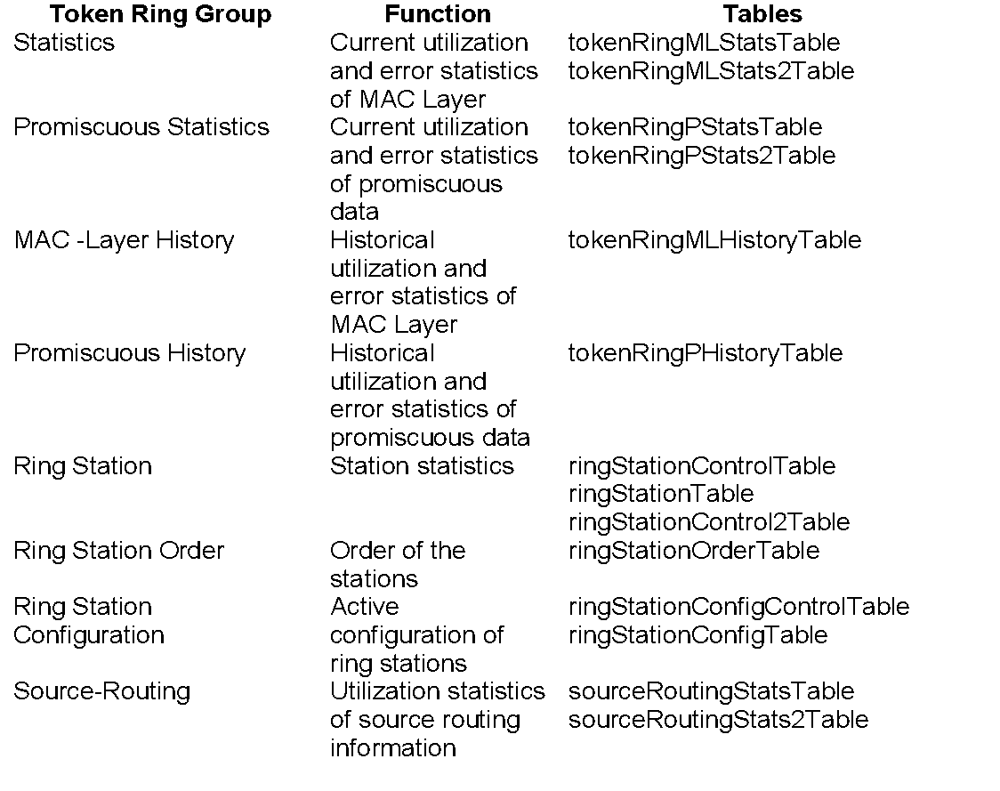
Chapter 8 SNMP Management: RMON
RMON TR Extension Groups
Table 8.3 RMON Token-Ring MIB Groups and Tables
  Notes
Two statistics groups and associated history groups
  MAC layer (Statistics group) collects
  TR parameters
  Promiscuous Statistics group collects packets
  promiscuously on sizes and types of packets
Three groups associated with the stations
Routing group gathers on routing
Network Management: Principles and Practice
© Mani Subramanian 2010
*

Slide 20
Chapter 8 SNMP Management: RMON
RMON2
Applicable to Layers 3 and above
Functions similar to RMON1
Enhancement to RMON1
Defined conformance and compliance
  Notes
RMON1 dealt primarily with data associated with the OSI data link layer. (OSI Layer 1 and Layer 2 )
RMON2 extends the monitoring capability to the upper layers, from the network layer to the application layer.
RMON2 Conformance Specifications
Conformance specifications were not specified in RMON1. They have been added in RMON2.

Slide 21
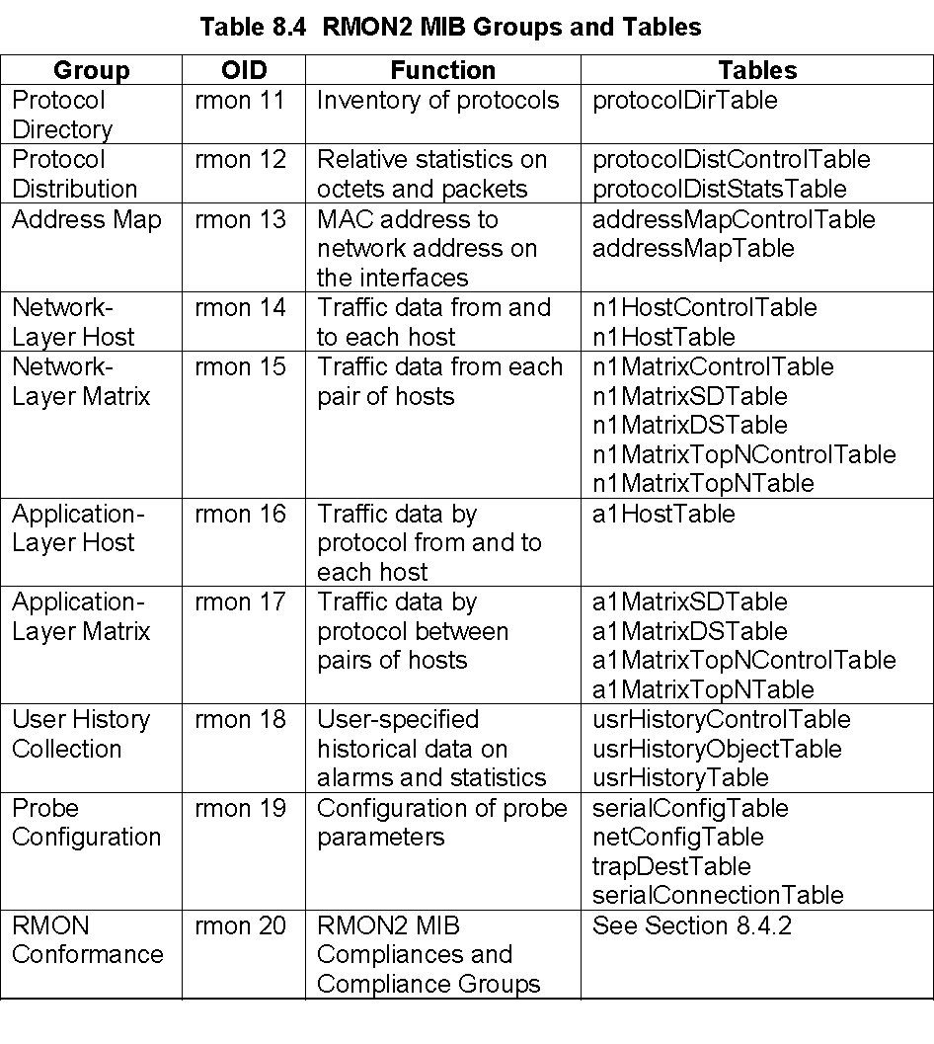
Chapter 8 SNMP Management: RMON
RMON2 MIB
The architecture of RMON2 is the same as RMON1.
RMON2 MIB is arranged into ten groups.
Table 8.4 shows the RMON2 MIB groups and tables.
  Notes

Slide 22
Chapter 8 SNMP Management: RMON
Case Study
A study at Georgia Tech on Internet traffic
Objectives
  Traffic growth and trend
  Traffic patterns
Network comprising Ethernet and FDDI LANs
Tools used
  HP Netmetrix protocol analyzer
  Special high-speed TCP dump tool for
  FDDI LAN
RMON groups utilized
  Host top-n
  Matrix group
  Filter group
  Packet capture group (for application level
  protocols)
  Notes

Slide 23
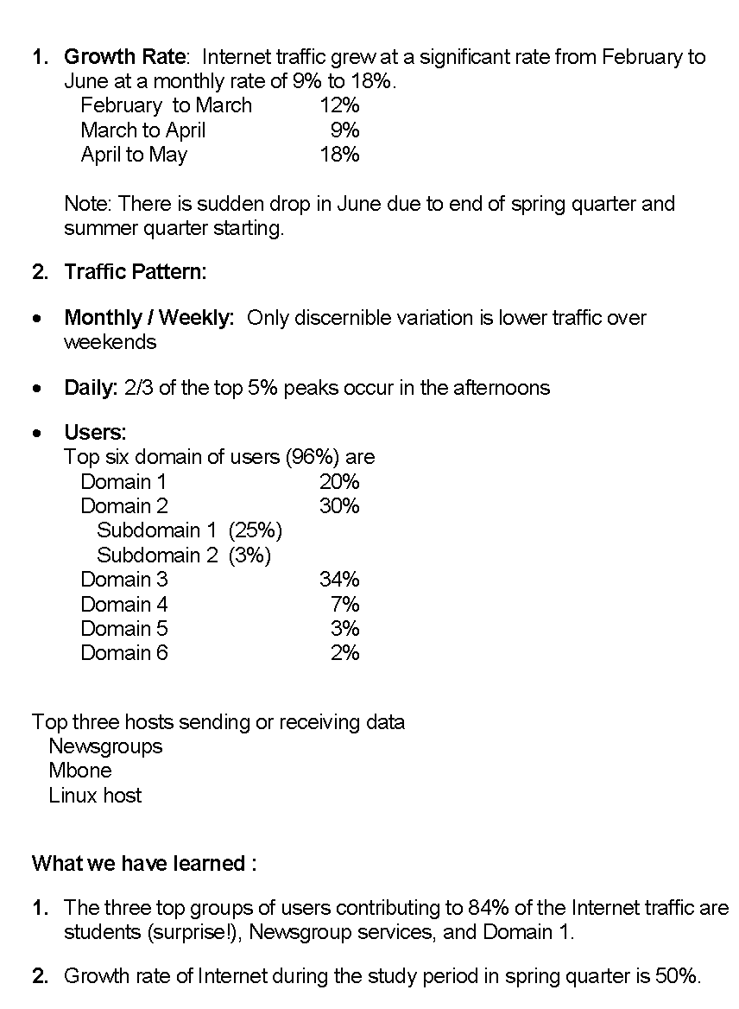
Chapter 8 SNMP Management: RMON
Case Study Results

Slide 24
Summary
In this chapter we discussed the enhancement to SNMP management by the introduction of remote monitoring, RMON.
Remote monitoring is monitoring the network using remotely positioned probes in various segments in the network.
RMON1 was initially defined for data link level parameters of Ethernet LAN. It was then extended to token-ring LAN.
RMON2 development followed to monitor and produce statistics for parameters associated with the upper layers, from the network to the application level.

